Slide 1

CFG équipe
Welcome to our project
Presentation
Project proposal
Of school

Slide 2
Project : System of school
Team : CFG Team
Member : Hong Kimleng (Leader)
Hok Kinleang
Meach Seaklav
Ngeav Bonat
Eab Pisey
Presentation leader:
Mr. Chan Sophal (TP)
Mr. Bou Channa (Course)

Slide 3
Introduction of project
This system can be helpful and essential or necessary to facilitates the work in school. Nowaday, almost
all works is done systematically because it saves time,exc. This system cans control all the processing.

Slide 4
System Management
Library
Information of students
Data of them follow by order letters exc.
Examination
System for examination can store score of them (we also write points to file).
Control all of files in school

Slide 5
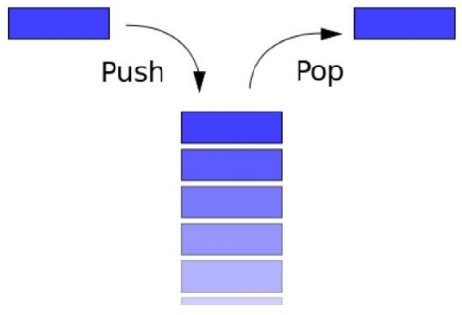
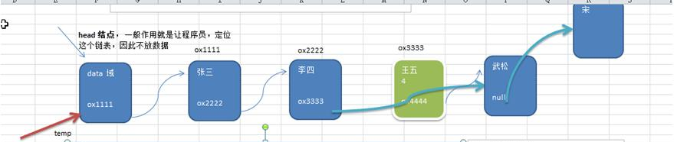
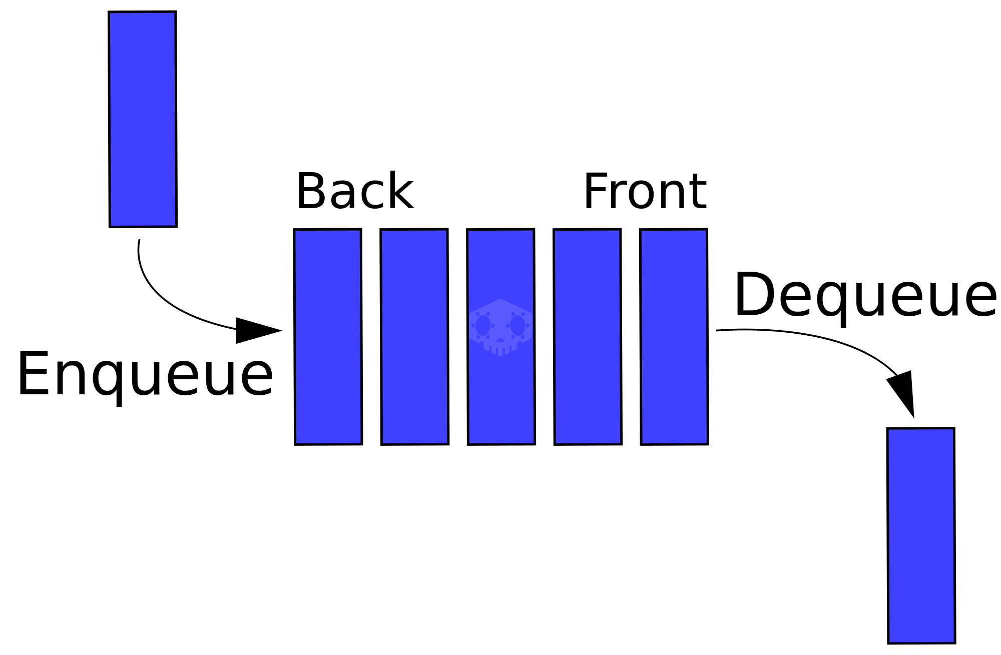
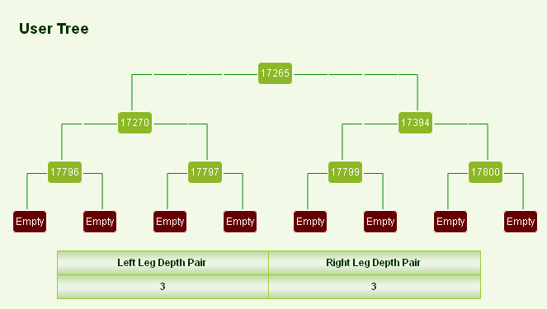
Data structure
we can use ……
Linked List
Use in this implemetation
Stack
queue
tree

Slide 6



Processing of code
Process follows by code
System management

Slide 7



Tools in here
Code blocks
Clion and dev

Slide 8

Merci pour votre attention à m’écouter !

